Slide 1
Final Internship Presentation
Cyril Nwako
- Company Private -

Slide 2
Contents
Schedule
INTRODUCTION
About Me
Summer Projects Assigned
PROJECTS
Background
Objective / My Task
Successes / Failures / How They Were Solved

Slide 3
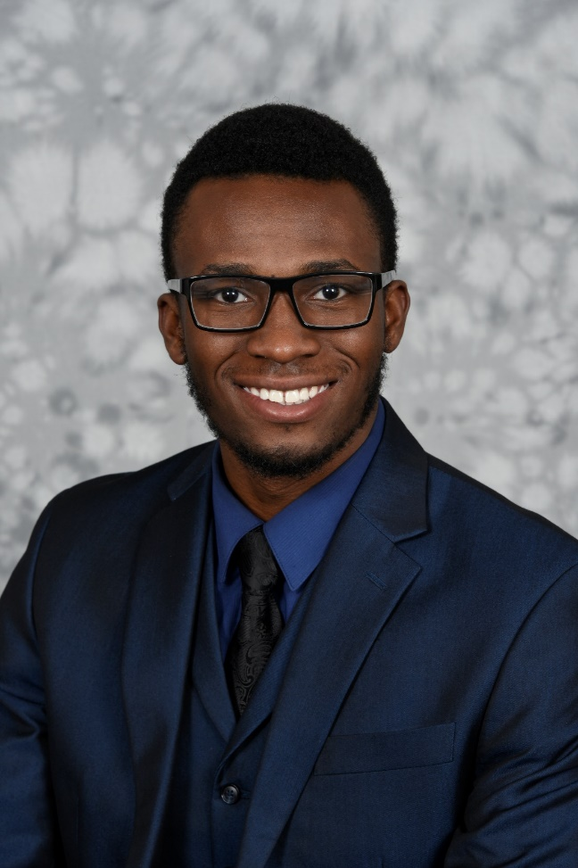

Introduction
About me
Rutgers University- New Brunswick
Major: Mechanical Engineering
Economics
Graduation: May 2020
Supervisor: KW Lee

Slide 4
Introduction
Summer Projects Assigned
Generator Torture Chamber: Construction
NaturaLINE Superheating
XtendFRESH (air leak, compression, heat age, hardness)
Cargo Sensor (FDM, MSC, Testing)
Variable Speed Generator

Slide 5
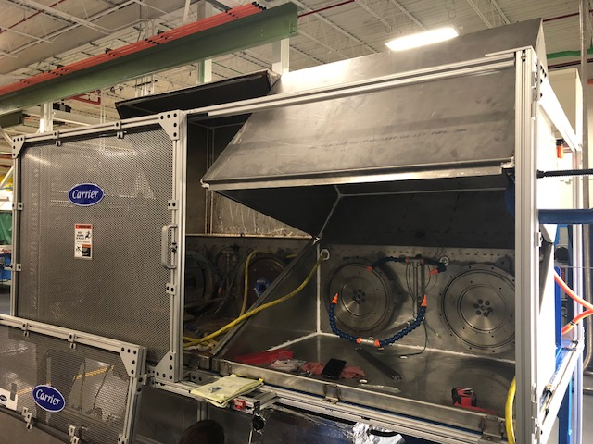
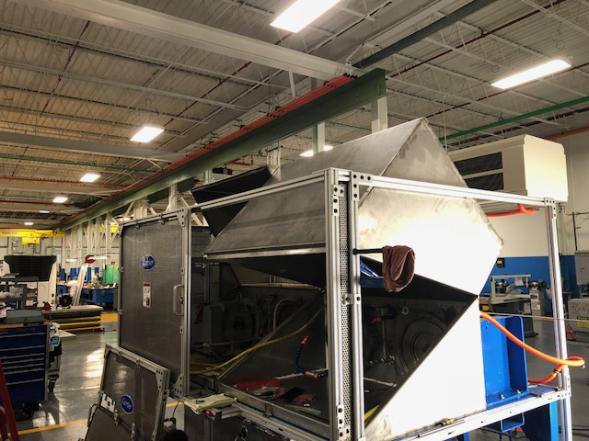
Generator Torture Chamber: CONSTRUCTION
Background
Tests the quality of our generators
Heaters act as a load for the generators
Hot water is constantly sprayed on generators to reveal manufacturing cracks or other issues
Notes:
2 generators in chamber
Alternate the heating load every 4 hours
Spray hot water to reveal cracks and impurities

Slide 6
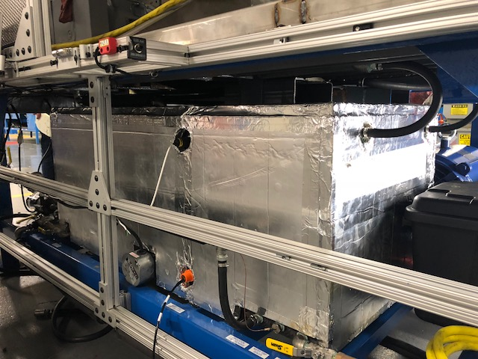
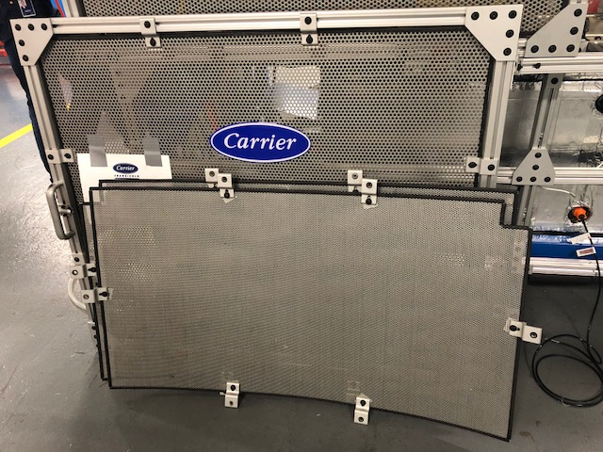
Generator Torture Chamber: CONSTRUCTION
Objective
Onboarding Project: Basic Functions
Construction of metal panels
Insulation of water tank
Notes:
Lab tools and machinery, lab techs
Water tank: inefficiency

Slide 7
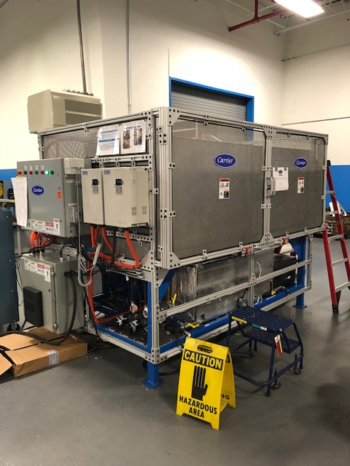
Generator Torture Chamber: CONSTRUCTION
Successes/Failures
Stainless steel panels were made for every side of the chamber
Adjustments were made around the engineers
Notes:
Good skill: working around people
Making adjustments

Slide 8
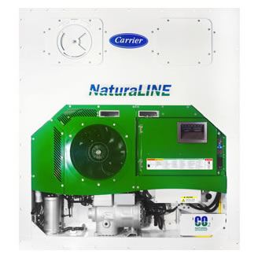
NaturaLine: Superheating
Background & Objective
Unloaded Mode
Alarm 03- “Loss of Superheat Control” was causing issues in the field
Notes:
Unloaded mode-During periods of low load in a container, some refrigerant leaving the intercooler goes back into the compressor

Slide 9
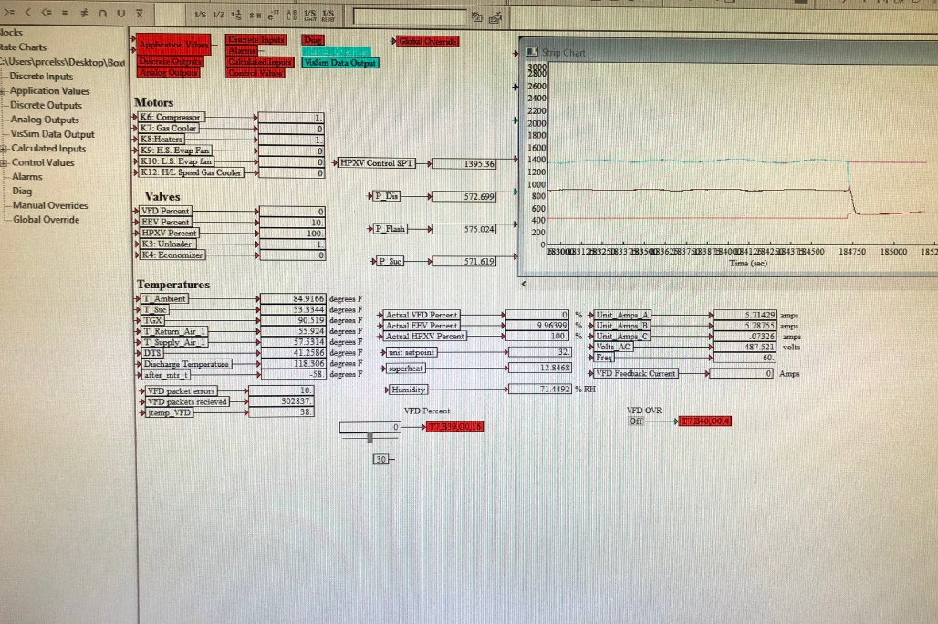
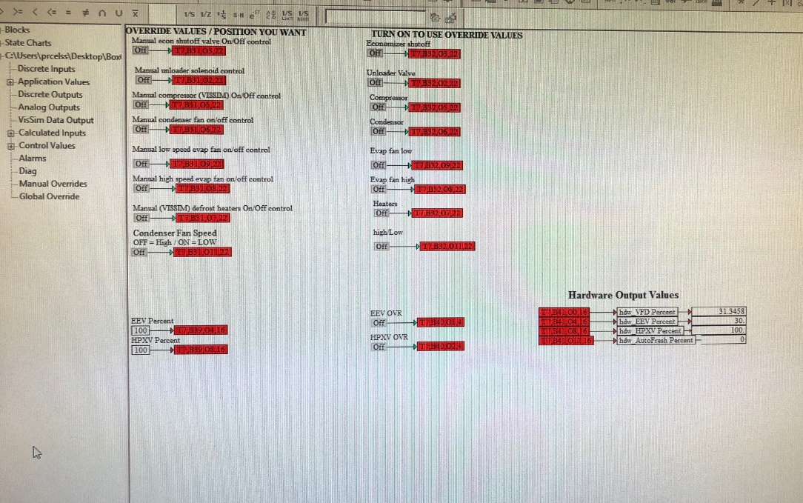
NaturaLine : Superheating
Successes/Failures
A lot of trial and error
Constantly changing the temperature set point and manual override
Notes:
Mimic field conditions
Try multiple temperatures
Ensure alarm 03 was not necessary
Software was changed

Slide 10
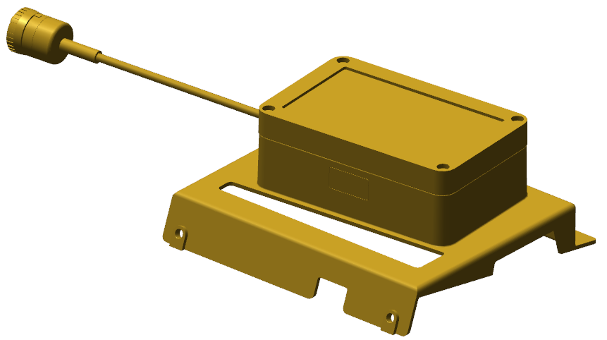
Cargo Sensor
Background
Uses infrared sensor to sense whether there is cargo in a container

Slide 11
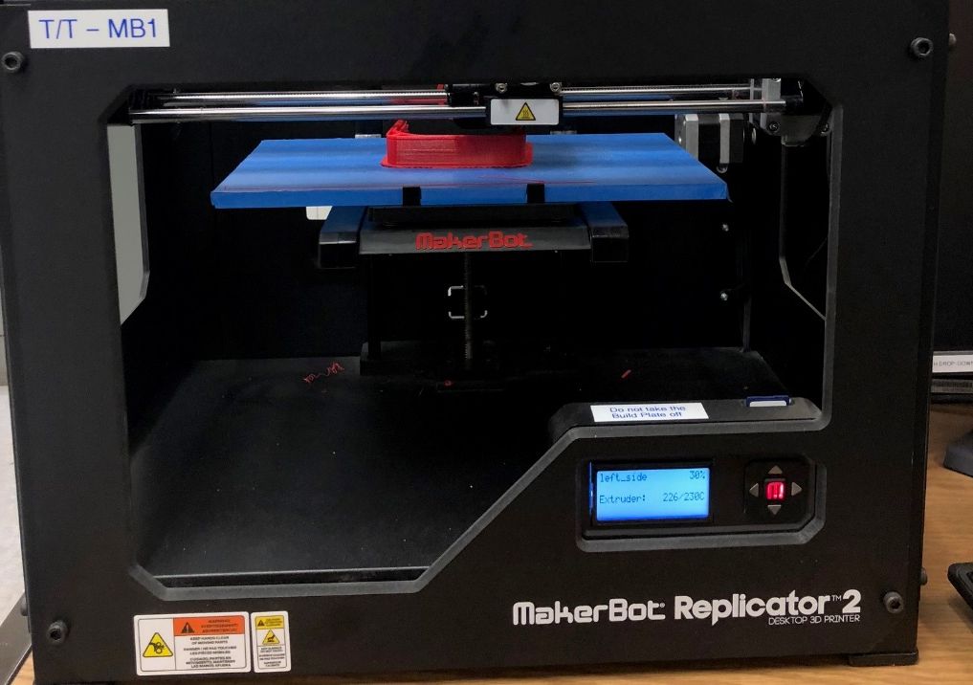
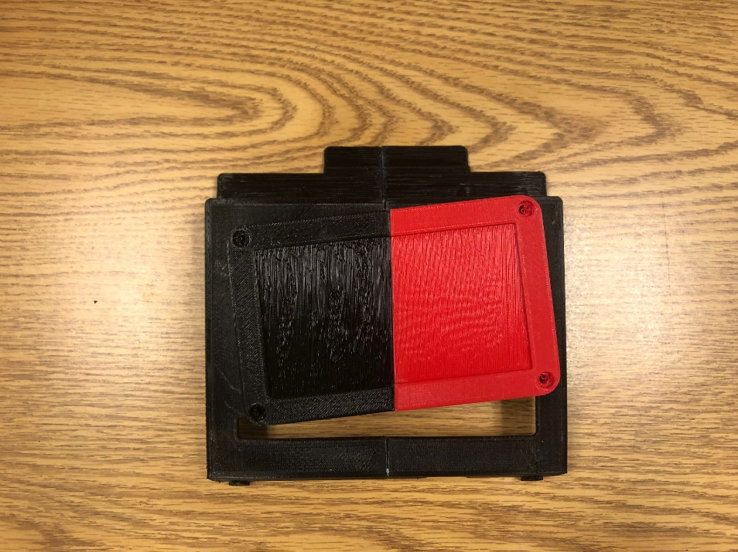
Cargo Sensor
Objective: 3D Print
With the design we received, we had to make sure it fit in our units
Notes:
Check measurments and dimensions

Slide 12
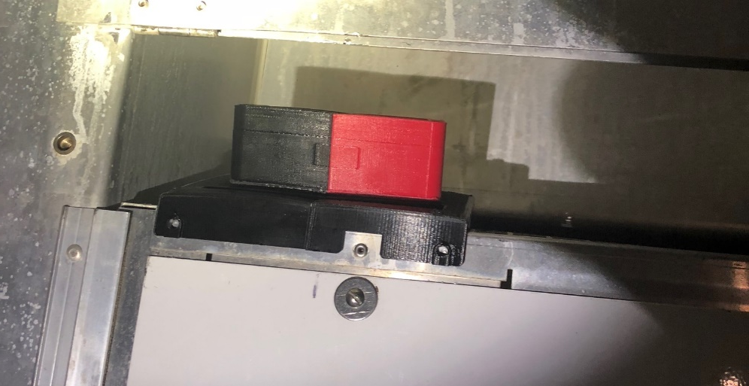
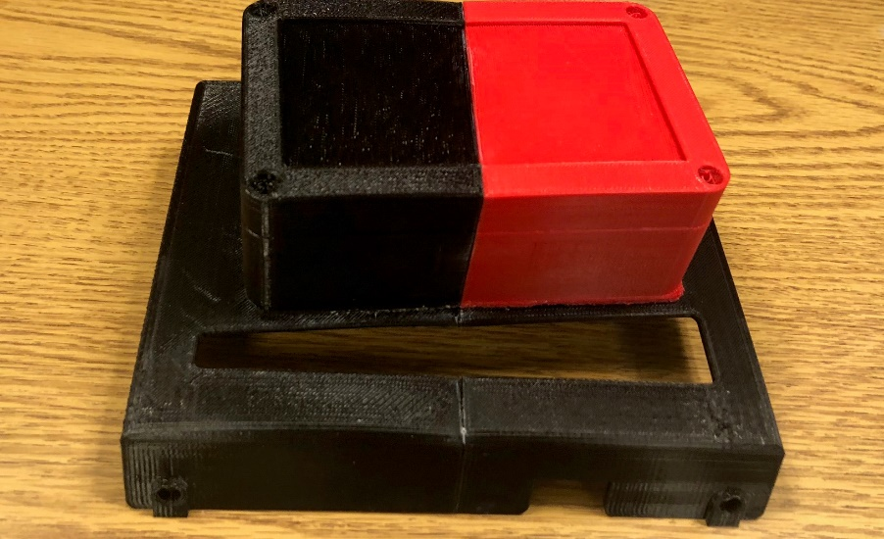
Cargo Sensor
Successes/Failures: 3D Print
Successfully able to print and fit the sensor into a unit
Notes:
Easy fit
No struggle

Slide 13
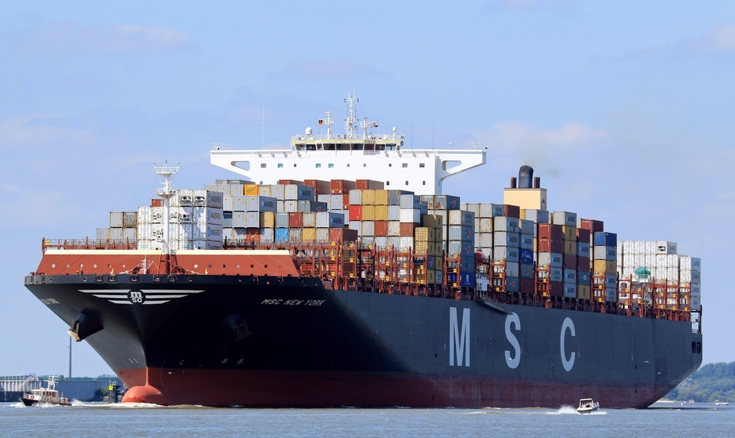
Cargo Sensor
Objective: MSC Packaging
In order to make sure our sensors work well, we had to send MSC multiple sensors so they could test
5 functions of the cargo sensor: battery dead, cargo present, not present, cargo present with low battery, cargo not present with low battery
Notes:
Now that they fit, need to WORK PROPERLY

Slide 14
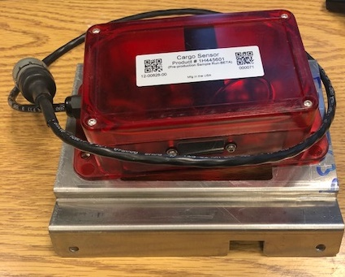
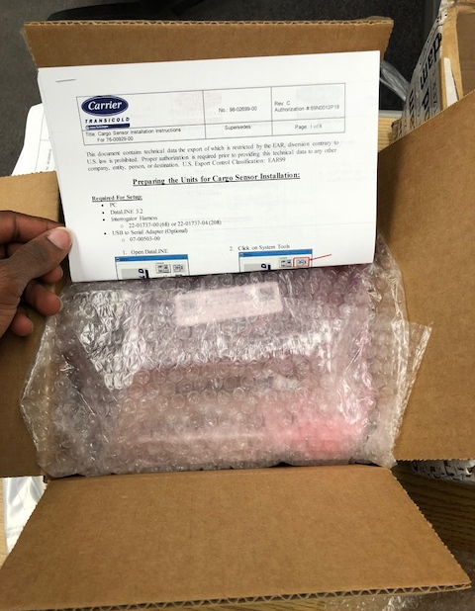
Cargo Sensor
Successes/Failures: MSC Packaging
We had to assemble and ship them
Easy assembly, very practical
Notes:
Assemble and ship.
Lightweight, smart

Slide 15
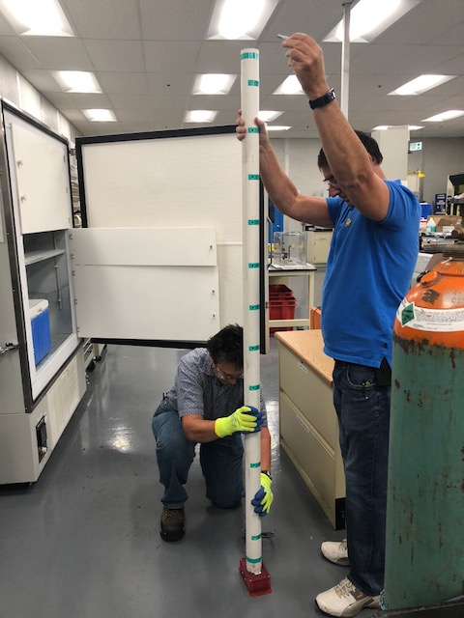
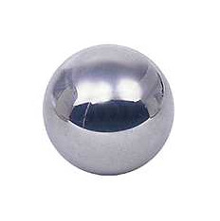
Cargo Sensor
Objective: Impact Test
Chill a cargo sensor to -40°C
Drop a weight on it from 6 ft high
2 in steel ball, 1.2 lb

Slide 16
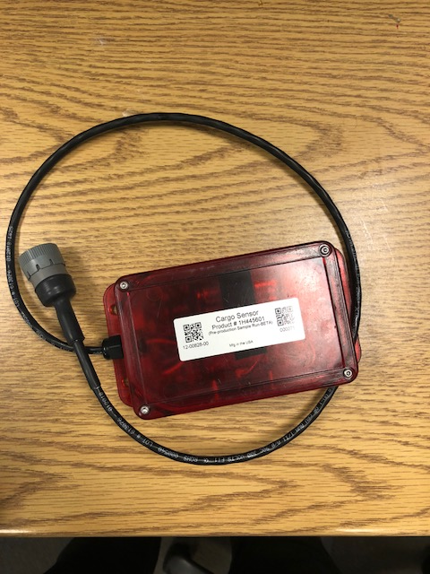
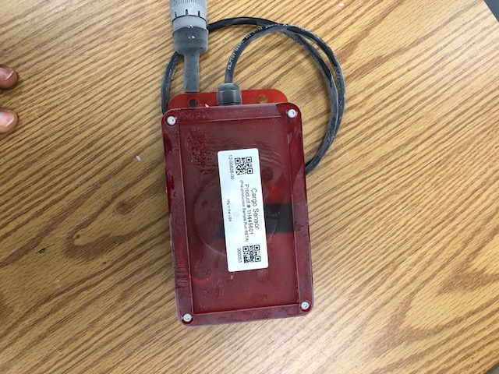
Cargo Sensor
Successes/Failures: Impact Test
No change, no or cracks damage in housing

Slide 17
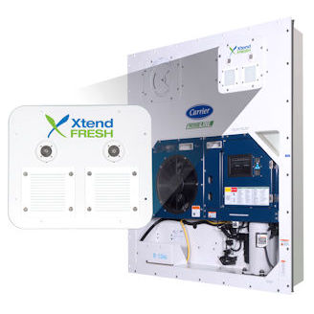
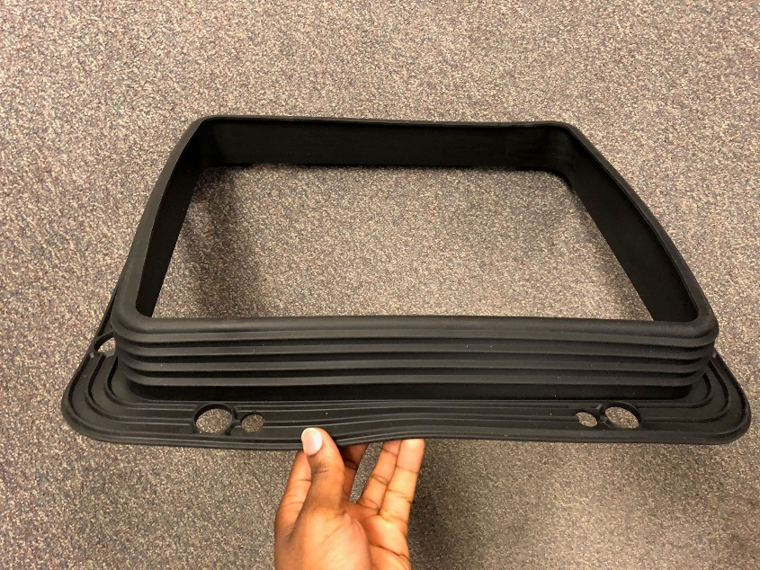
XtendFRESH Testing
Background
Controls CO₂ and O₂ levels in the container to slow ripening
My Focus: The New Glove Gasket Design
Notes:
If we’re to control air levels, we cant have leaks
Gaskets must be sturdy and durable

Slide 18
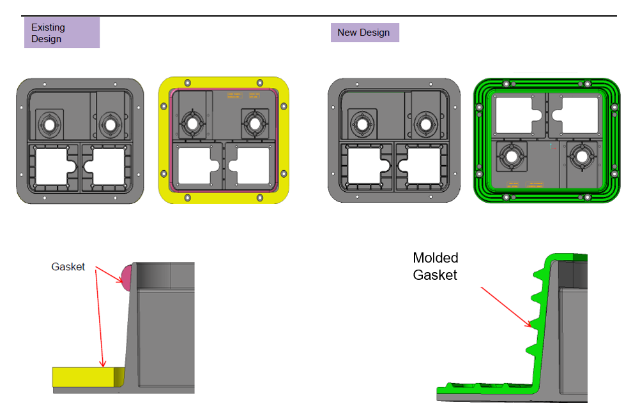
XtendFRESH Testing
GLOVE GASKET DESIGN
Notes:
Old is costly
Less contact
No ribs

Slide 19
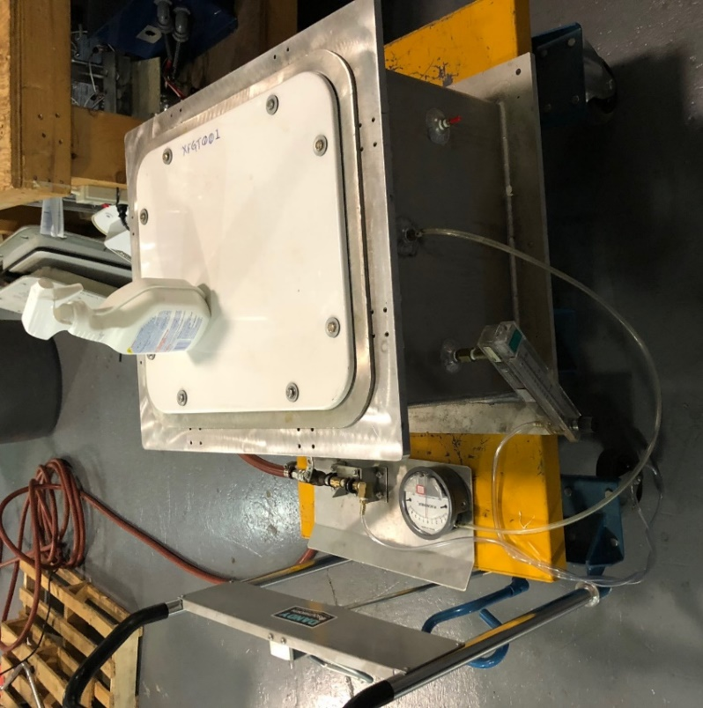
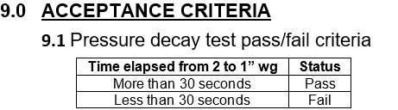
XtendFRESH Testing
Objective: Air Leak Test
Collaborated with Alex
Determine how the gasket handles pressure on XtendFRESH and ABS panel

Slide 20
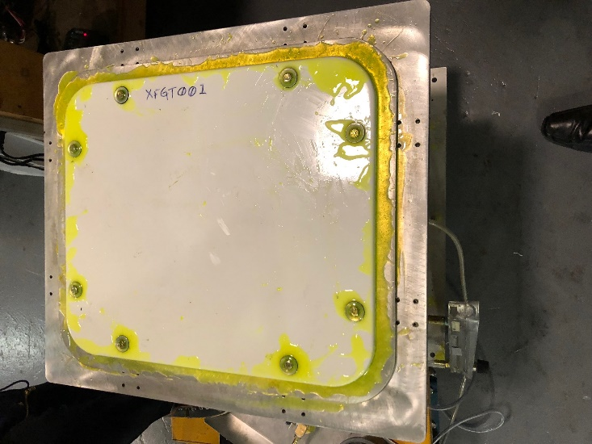
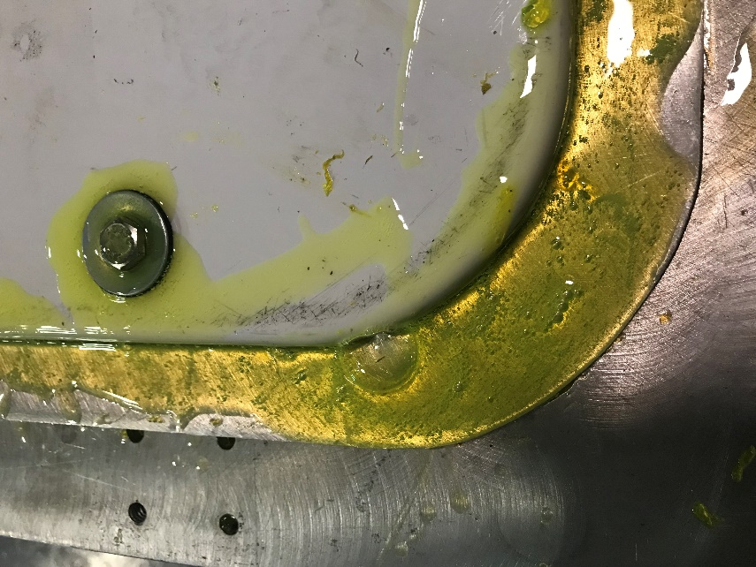
XtendFRESH Testing
Successes/Failures: Air Leak Test
Troubleshoot methods to achieve desired results
Teflon tap, torque increase to 140 in*lb, panel change, and gas leak detector
Notes:
Gas leaks shows deformaties in gasket or panel

Slide 21
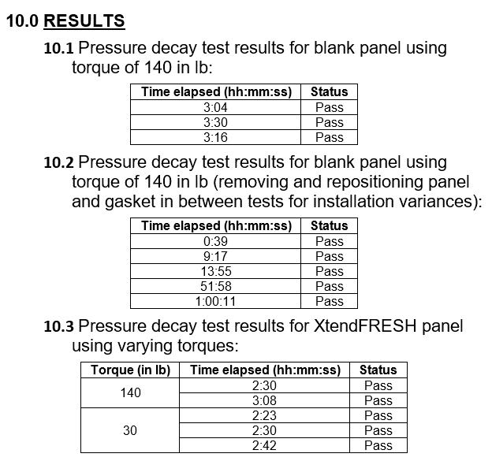
XtendFRESH Testing
Successes/Failures: Air Leak Test
Blank Panel
XtendFRESH Panel
Notes:
2 PANELS: BLANK AND XTENDFRESH
Same panel
Removing and re-installing panel
XtendFRESH at different torques

Slide 22
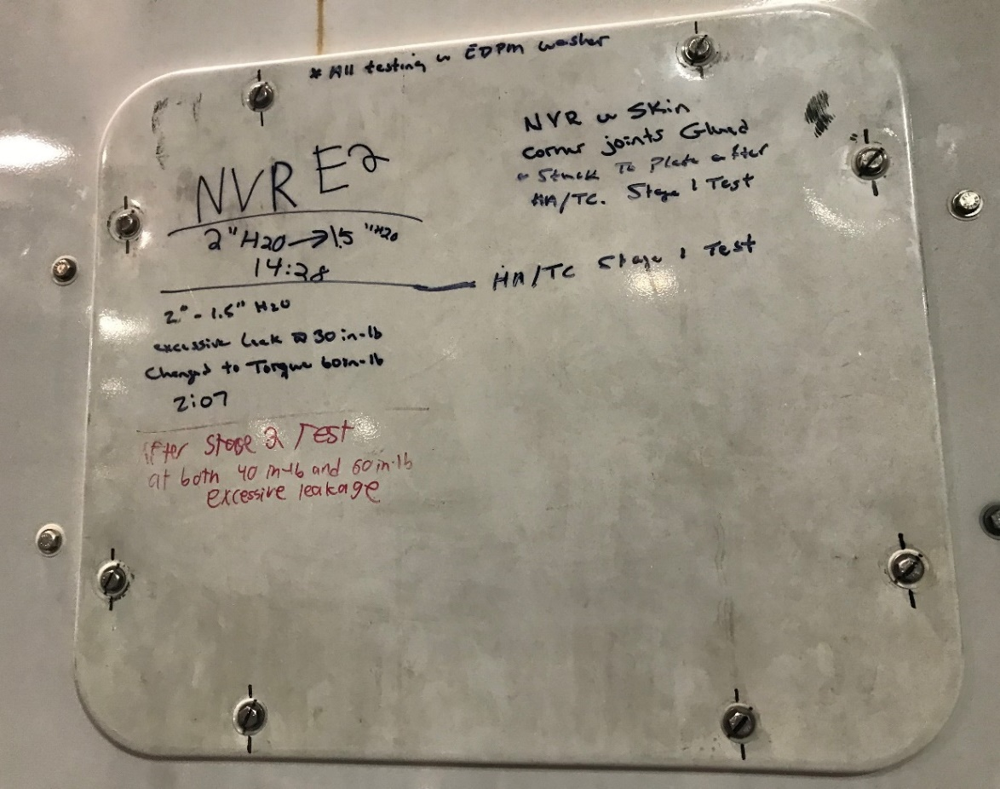
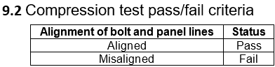
XtendFRESH Testing
Objective: Compression Test
Determine the rigidness of our application process through the panel’s torque retention performance
Notes:
Make sure panel had sturdy fit, good torque retention
Sharpie lines

Slide 23
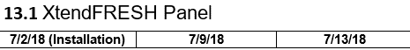
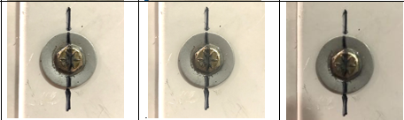
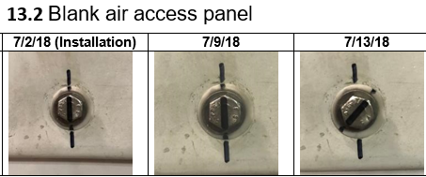
XtendFRESH Testing
Successes/Failures: Compression Test
After 3 weeks the blank panel was found at a torque between 125 and 130 in*lb
After 4 weeks, the XtendFRESH Panel was found at a torque between 135 and 140 in*lb
Notes:
2 PANELS: BLANK AND XTENDFRESH
Old gasket had worse torque retention

Slide 24
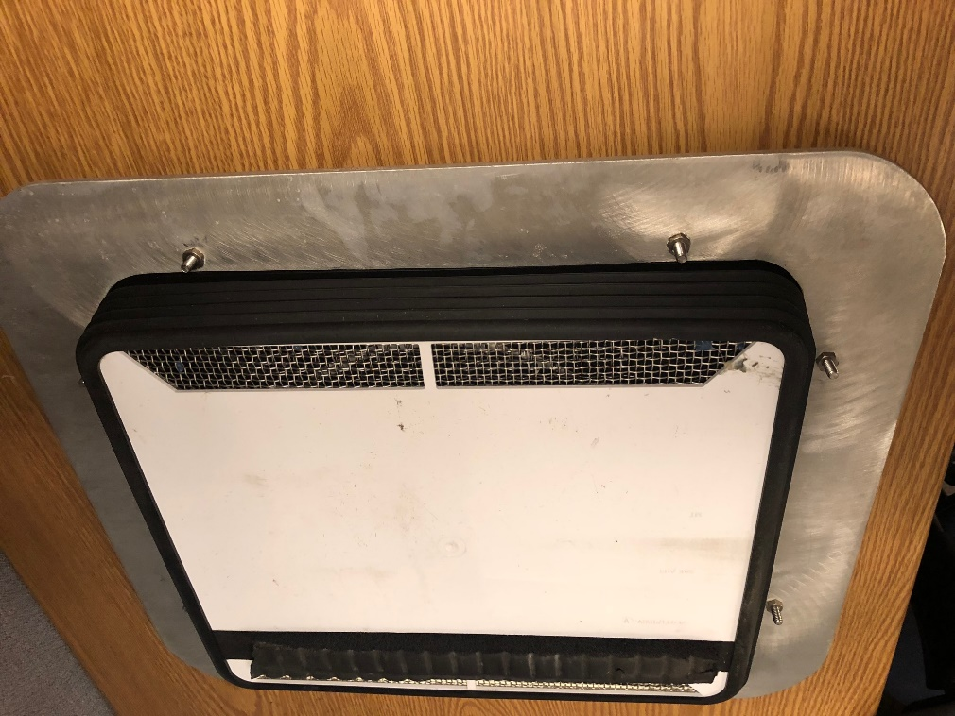
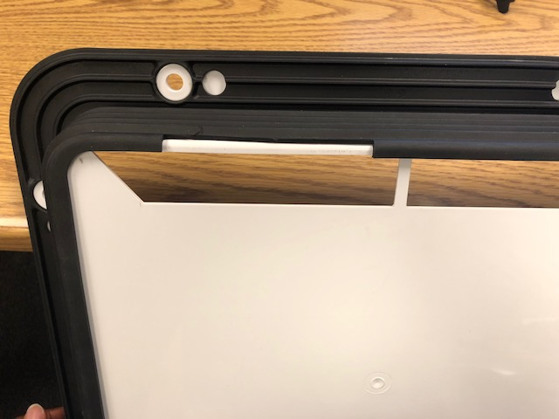
XtendFRESH Testing
Objective: Hardness Test
For further testing, we wanted to see how hard the gasket was
Notes:
Cut off a slice of gasket

Slide 25
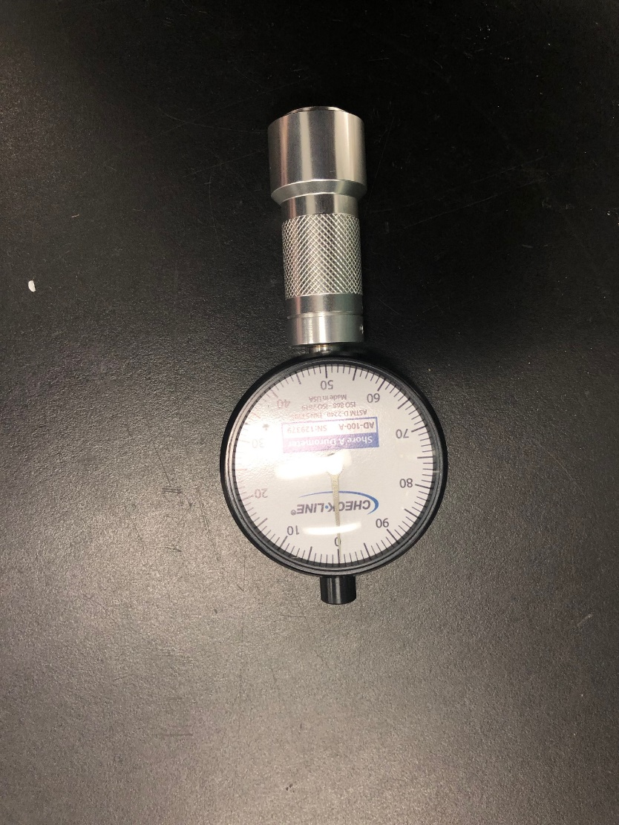
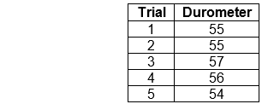
XtendFRESH Testing
Successes/Failures: Hardness Test
Took hardness readings at different points on gasket
Average: 55 durometers

Slide 26
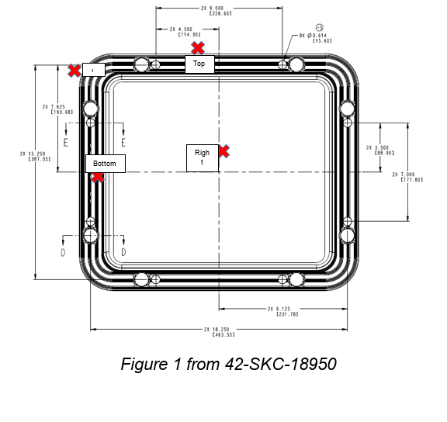
XtendFRESH Testing
Objective: Heat Aging Test
Determine how the gasket deforms while under high temperatures (60°C) for extended periods of time
Notes:
Replicate heat deterioration in field

Slide 27
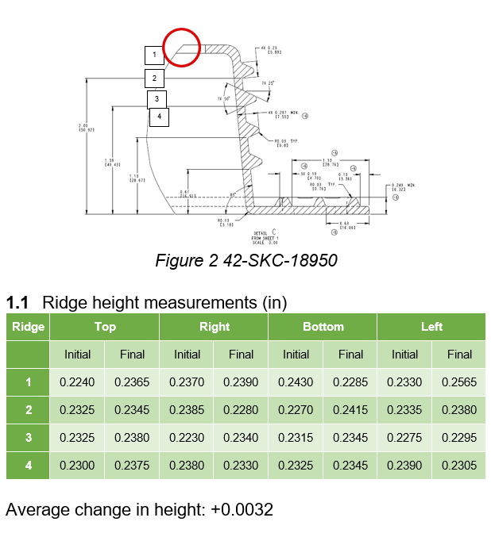
XtendFRESH Testing
Successes/Failures: Heat Aging Test
We noticed little to no deformation in most areas on the gasket
Big improvement over old gasket design
Notes:
Old gasket: .5 inch

Slide 28
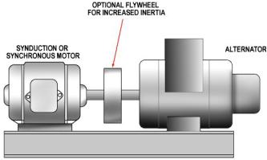
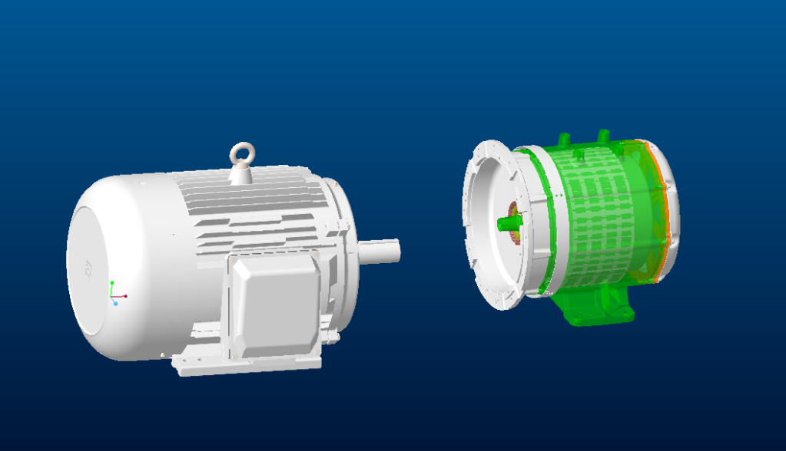
Variable SPEED Generator
Background
Design a platform and coupling system for a variable speed generator that can handle 50 Hp

Slide 29
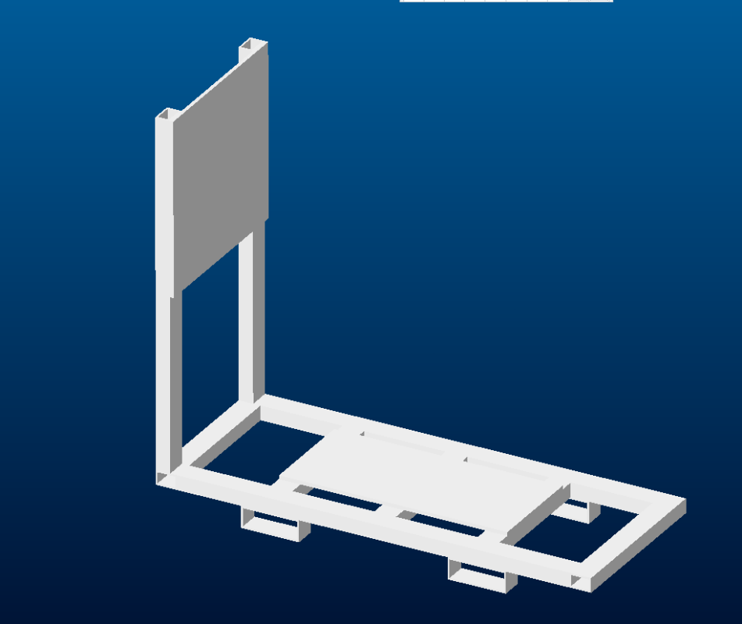
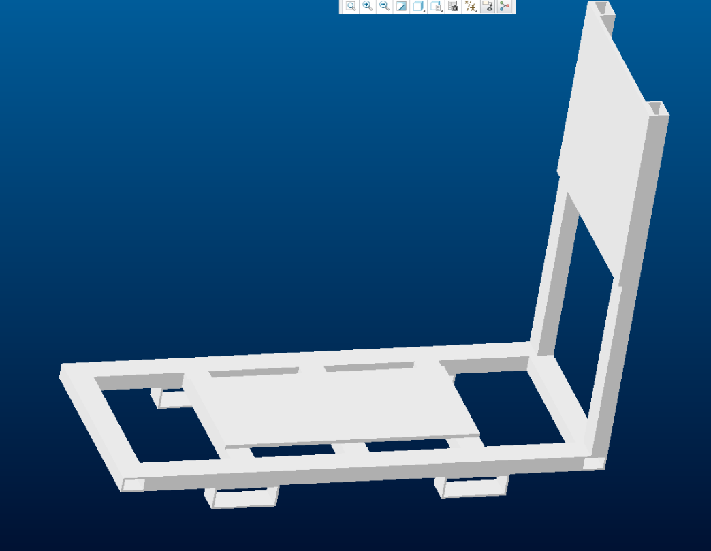
Variable SPEED Generator
Objective
Design Platform
Be reasonable with material, weight, and cost in mind
Notes:
Hollow material now, before solid
Heavier
Costlier
Not as practical

Slide 30
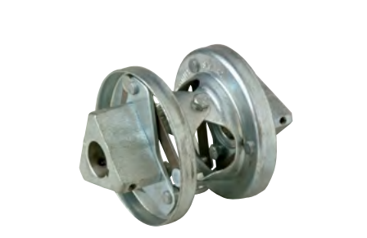
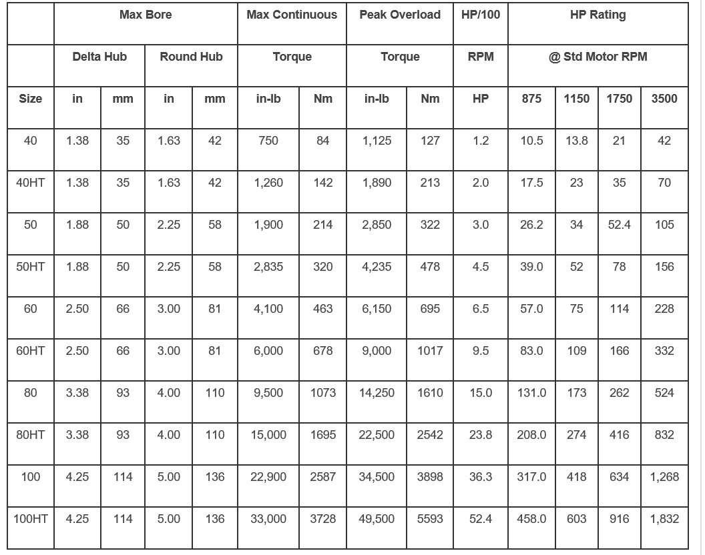
Variable SPEED Generator
Objective
Calculate what size coupling was necessary for 2000-2200 RPM and 50 HP
1.88
Shaft to Shaft – Hubs Mounted Externally
Notes:
External mounted hub, easier to use and the flanges fit better
2000 RPM translates to about 2.5 HP/100 RPM
Delta hub necessary is 1.88 in

Slide 31
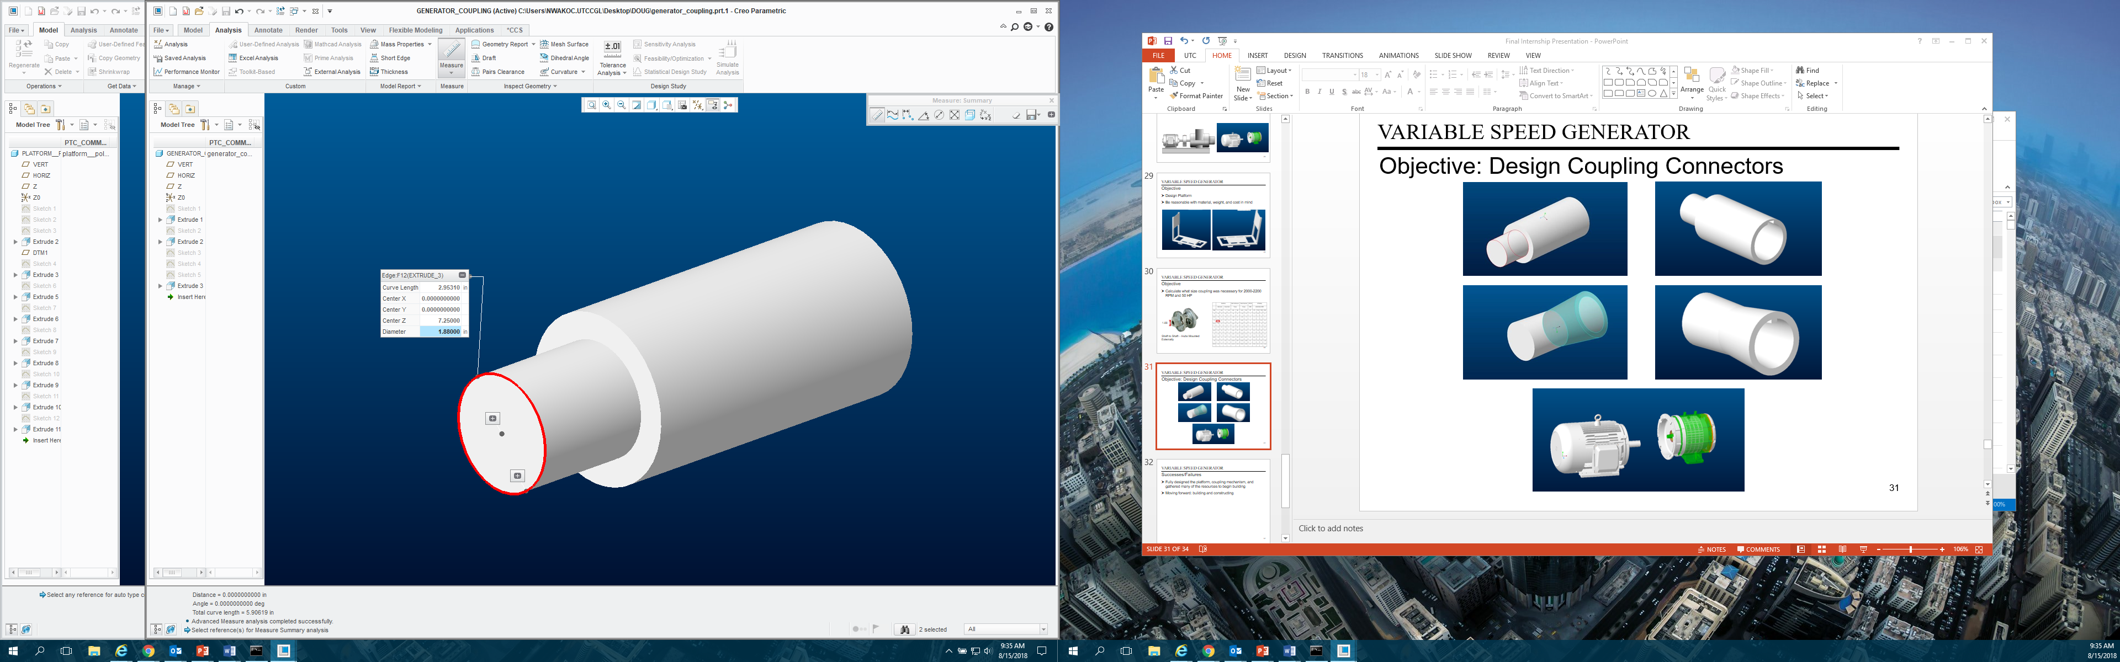
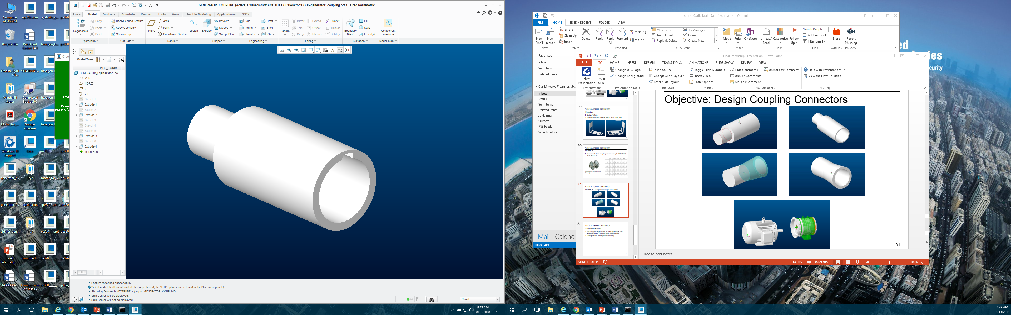
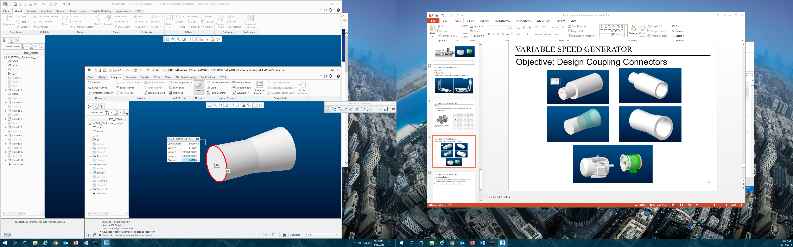
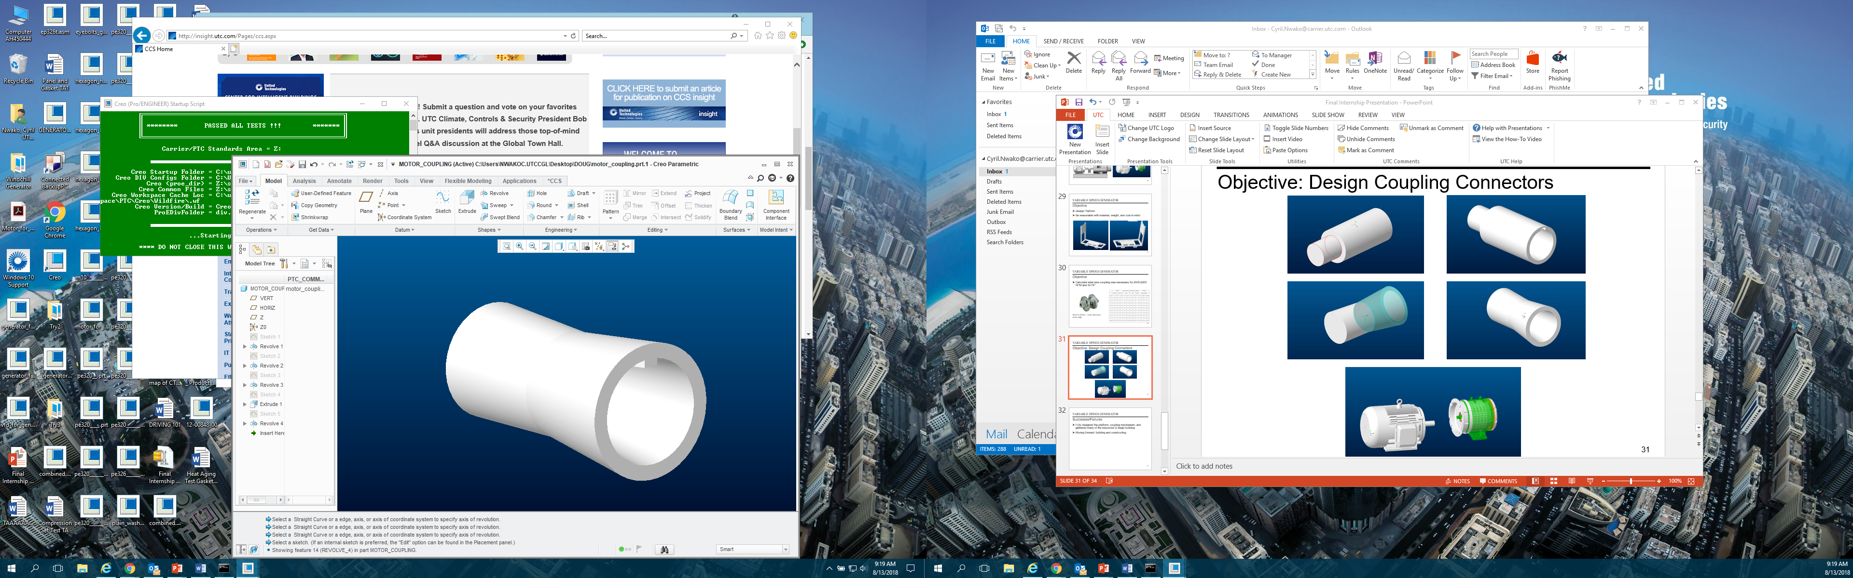

Variable SPEED Generator
Objective: Design Coupling Connectors

Slide 32
Variable SPEED Generator
Successes/Failures
Fully designed the platform, coupling mechanism, and gathered many of the resources to begin building
Moving forward: building and constructing

Slide 33
CCS AT A GLANCE
Feedback
OBSERVATIONS:
Friendly environment both inside and outside of the lab
Good place to learn technical and professional skills
RECOMMENDATIONS:
Intern Collaborations
Shadowing System

Slide 34

Questions?
Q/A

